Slide 1

Why Work?
William Messenger
Notes:
Buenos tardes. Me llamo Will Messenger. Now I must switch to English. I apologize that I only speak one of the two great languages of North America. Let me thank Andres Garcia for translating! Muchas gracias.

Slide 2
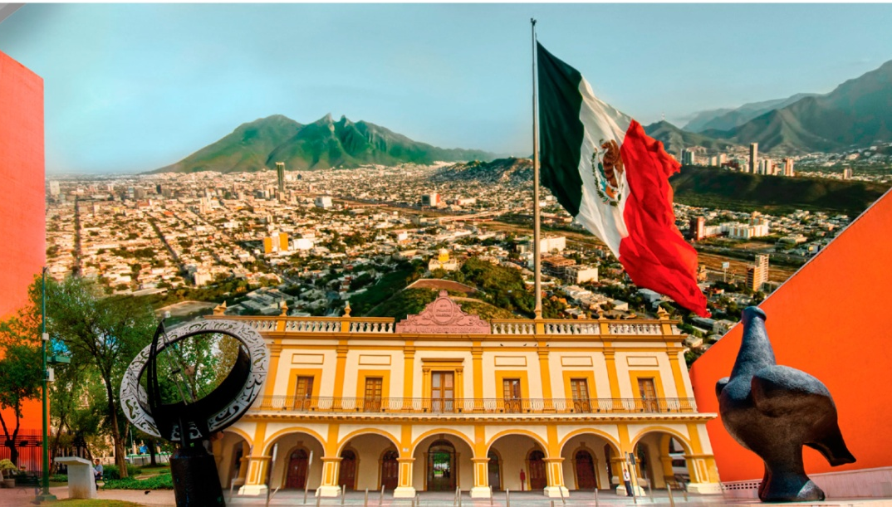
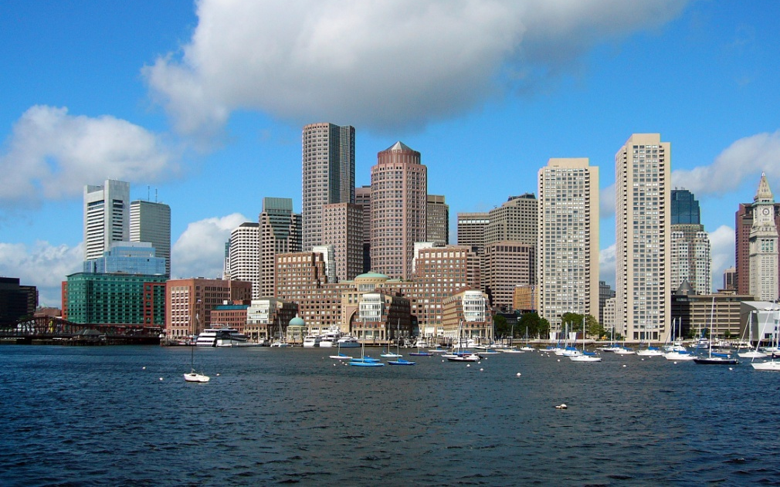
Notes:
I am honored to be with you here in Monterrey to explore why work was created. Monterrey is a hard-working city. Monterrey is the academic capital of Mexico. You have the highest productivity per capita in Mexico. I come from a hard working city, Boston. Boston is the academic capital of the United States. But Boston is only the 6th most productive city in the US. So we are a little bit behind you.

Slide 3
Notes:
What can someone from Boston say to be useful to Monterrey? Let’s turn to the greatest person ever to come from Boston, Benjamin Franklin. Benjamin Franklin was born in Boston in 1706.

Slide 4
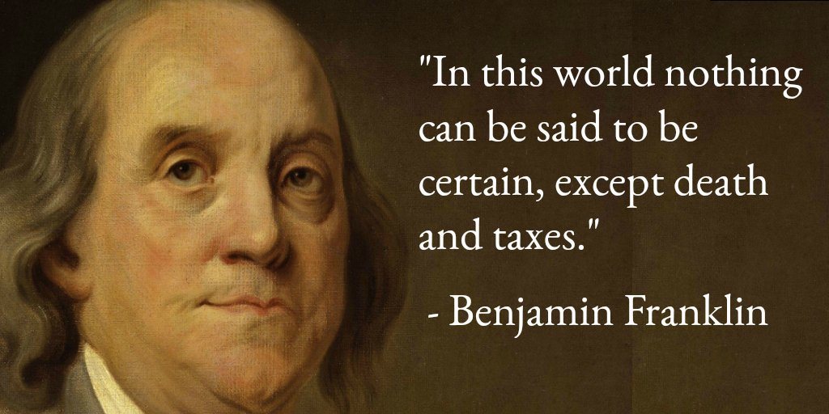
Notes:
Benjamin Franklin said this: “In this world nothing is certain but death and taxes.” It’s not an optimistic saying. “Nothing is certain but death and taxes.” Yet the saying is certainly true. I haven’t died myself, yet, but I have certainly paid taxes. Every time anyone in the US gets paid or buys something, they pay taxes. Same in Mexico, probably, yes? Every day this saying is proved hundreds of millions of times. So maybe this is the most proved saying in the world.

Slide 5

Notes:
But Benjamin Franklin forgot one thing: work. Work is as certain as death or taxes. The day you are born, your first breath takes work. Learning to walk takes work. Learning to speak, going to school, making breakfast, cleaning your room, it’s hard work. You get a job, maybe have a family, get an apartment or house, care for aging parents. Life is full of work.

Slide 6
Notes:
Some people say that work as grim as death and taxes. After all why do you work? Because you have make money, to take care yourself and your family! Or maybe you work at home and you don’t get paid. But your family still depends on your work to clean the house, cook the meals, do the laundry, care for the children or the elders. Either way, you don’t work for the fun of it, do you? If they stopped paying you, would you keep going to work? I love my job, but if they stopped paying me, I would have get another job because I have to work support my family.

Slide 7
Notes:
I am making work sound severe, and I think the Spanish words for work are severe. El trabajo comes from the Latin word for torture. La labor, straining the muscles. We must work when we would rather be relaxing with our family. Many people labor two or three jobs just to make enough money. At work you might endure the torture of a bad boss, sexual harassment, dangerous work environment, long hours, hostile co-workers, hostile customers, low pay, humiliation, lack of opportunity for a better job.

Slide 8
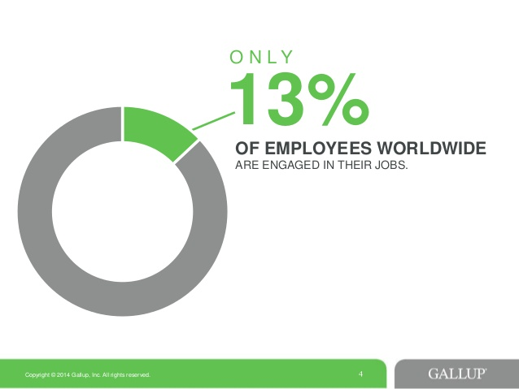
Notes:
Around the world, 87% of workers are “disengaged” in their work, according to a study of 155 countries done by Gallup. People would rather be doing anything else besides working.
But God didn’t create work as a punishment, or torture, or labor. God created work as a good thing. Let’s explore what is good about work, or what could be good about work.
https://www.gallup.com/workplace/231668/dismal-employee-engagement-sign-global-mismanagement.aspx. Accessed Aug. 2, 2019.

Slide 9
Why Work?
¿Por qué trabajar?
Work is good for you
El trabajo es bueno para ti
Notes:
First of all: work is good for you.
You are created with a desire to work. And working is essential to physical, mental, and emotional health. I see this every week because I lead the 2-year-olds in our kids church. And 2-year-olds love to work. They want to build with blocks. Change the dolls diapers and dress them. Cook the play food and pretend to eat it.

Slide 10


Slide 11
Six days you shall labor and do all your work, but the seventh day is a sabbath to the Lord your God.
(Exodus 20:9–10, NIV)
Trabaja seis días, y haz en ellos todo lo que tengas que hacer, pero el día séptimo será un día de reposo para honrar al Señor tu Dios.
(Éxodo 20:9-10, NVI).
Notes:
God has built into us the desire to work. Did you know that is in the Ten Commandments? One of the Commandments is, “Six days you shall labor and do all your work, but the seventh day is a sabbath to the Lord your God.” (Exodus 20:9–10, NIV). God says, Work six days, then take one day off, then go back to work. Rest is important—sábado—but in cycle of 6 parts work, and 1 part sábado.

Slide 12
Why Work?
¿Por qué trabajar?
Work is good for you
  Desire to work
  Provide for family
El trabajo es bueno para ti
  Deseo de trabajar
  Proveer para la familia
Notes:
And that brings us to the second way work is good for you. Work is how you provide for yourself and your family. We already talked about this as a bad thing. You have to go to work, otherwise you’ll starve. But actually it is a good thing. Working to provide for yourself and your family is wonderful. It is good to be able feed yourself and your family. When one of my daughters asks me for something—clothes or a book or music lessons—it feels good to be able to give it to her.

Slide 13
Whoever does not provide for relatives, and especially for family members, has denied the faith and is worse than an unbeliever.
(1 Timothy 5:8)
El que no provee para los suyos, y sobre todo para los de su propia casa, ha negado la fe y es peor que un incrédulo.
(1 Timoteo 5:8)
Notes:
God expects everybody to contribute something to their own needs and their families, to the degree we are able. The Bible says, “Whoever does not provide for relatives, and especially for family members, has denied the faith and is worse than an unbeliever” (1 Timothy 5:8). Or to put it another way, doing the work God gives you to do is an essential part of being a believer in Jesus. Working is as important as worship, or more.

Slide 14
Notes:
So, I’ve said that work is good for you because God has made you with a desire and ability to provide for yourself and your family.

Slide 15
Why Work?
¿Por qué trabajar?
Work is good for you
  Desire to work
  Provide for family
Work serves others
El trabajo es bueno para ti
  Deseo de trabajar
  Proveer para la familia
El trabajo sirve a otros
Notes:
But work is not just another kind of egoísmo. There is a second reason to work: to serve others, not just yourself and your family. Yes, work to earn the paycheck. But you can do your work in a way that serves others, not just the minimum to earn your pay. For example, I have a friend who is a police woman in Boston. She told me, “My job is to walk the street and keep an eye out for crime. But I do more than that. I meet the people. I ask about their families. I earn their trust. I talk to the drug users too. I tell them if they want to stop using drugs, come to me. If they walk into social services and ask to enter a treatment program, it could take weeks. If I, as a cop, take them to the emergency room, they will get into a program right away. There’s a lot of good you can do as a cop that nobody else can do.”

Slide 16
Notes:
I mention her because in some ways she doesn’t like her job. She says that women cops don’t get respect from police management. She gets all the weekend and holiday shifts, and she gets stuck with overtime when everyone else wants to go home on time. It’s not her ideal job. But as long as she has that job, she’s committed to serving the people on her beat as much as she can.

Slide 17
Why Work?
¿Por qué trabajar?
Work is good for you
  Desire to work
  Provide for family
Work serves others
  Products and services
El trabajo es bueno para ti
  Deseo de trabajar
  Proveer para la familia
El trabajo sirve a otros
  Productos y servicios
Notes:
Let’s explore ways your work can serve others.
First, somebody uses the products or services that your work provides. If you provide good products and services, you meet other people’s needs, whatever you make or do. Simple, but powerful.

Slide 18
Our people must learn to devote themselves to doing what is good, in order to provide for urgent needs and not live unproductive lives.
(Titus 3:14)
Que aprendan los nuestros a empeñarse en hacer buenas obras, a fin de que atiendan a lo que es realmente necesario y no lleven una vida inútil
(Tito 3:14)
Notes:
The Bible gives advice about this: “Our people must learn to devote themselves to doing what is good, in order to provide for urgent needs and not live unproductive lives.” (Titus 3:14).
Some people have jobs where it’s easy to see how their work meets people’s needs. Doctor, nurse, teacher, farmer, cook, mother, airline pilot, police officer.

Slide 19
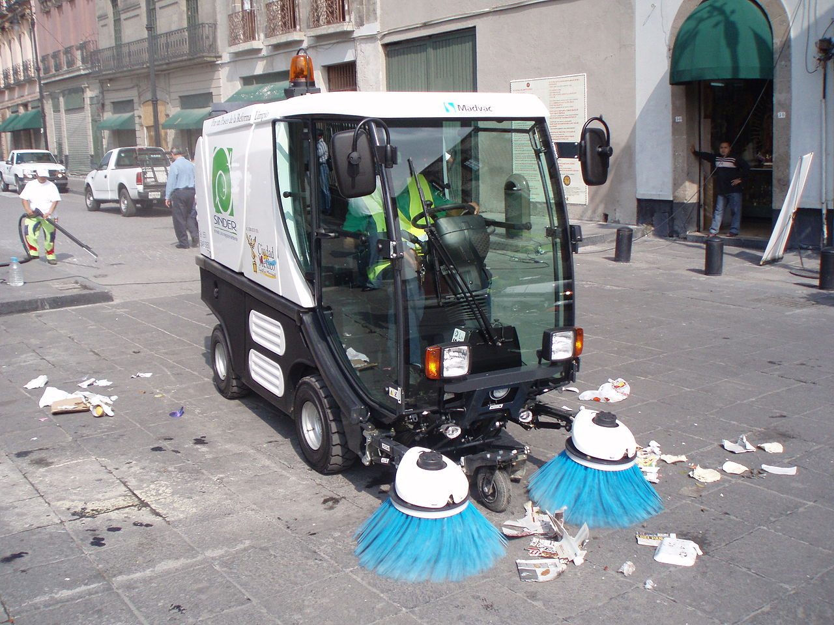
Notes:
And street cleaners. Street cleaners do more to prevent disease than all doctors and nurses combined. Before street cleaners, you could get typhus, dysentery, cholera and the plague just from walking the filthy streets. Thank God for street cleaners.

Slide 20
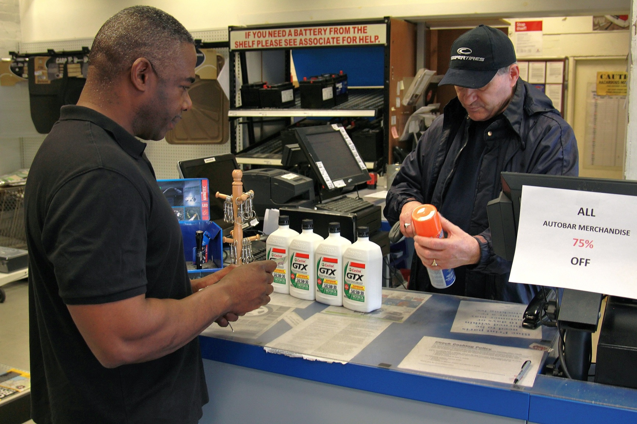
Notes:
Other jobs, it’s not so easy to see how they serve people. Consider Carlos, whose works behind the counter in an auto parts store. He says this: “I have a great job because I make a difference in people’s lives every day. My customers are here because somebody’s car is broken. And you know without a car, you can’t get to work. So they need parts fast. But people don’t always know exactly what part they need. So I ask them, what are you going to use it for, what make and model is it going into? What tools are you going to need? If the part is out of stock, I try to find a substitute. If I do my job right, people get their cars back safe, reliable and quickly.”

Slide 21
Whatever you do, work at it with all your heart, as working for the Lord.
(Colossians 3:23)
Hagan lo que hagan, trabajen de buena gana, como para el Señor.
(Colosenses 3:23)
Notes:
I love this story because my grandfather was an auto mechanic. He got people back on the road so they could make a living, or visit family, or get to school. People didn’t respect his job very much. He was considered a “laborer” rather than a “professional.” But according to the Bible, all kinds of work are important to God. “Whatever you do, work at it with all your heart, as working for the Lord.” (Colossians 3:23). Granddad was proud of his work. And so am I.

Slide 22
Why Work?
¿Por qué trabajar?
Work is good for you
  Desire to work
  Provide for family
Work serves others
  Products and services
  Co-workers
El trabajo es bueno para ti
  Deseo de trabajar
  Proveer para la familia
El trabajo sirve a otros
  Productos y servicios
  Compañeros de trabajo
Notes:
That brings us to the second way you can serve others at work: the way you treat your co-workers. You can treat your co-workers merely as a means to get what you want at work. You can gossip about them. Disrespect them. Hide information from them. Or you can serve them. You can share your knowledge, your contacts, your information. You can stand up for someone who is being treated unfairly. You can mentor someone who needs your help. You can welcome the people who don’t fit in and help newcomers learn the ropes. You can treat all your co-workers with respect, even the invisible ones like the person who empties the trash and cleans the toilets.

Slide 23
Notes:
I have a story myself about serving a co-worker. I used to work at the management consulting firm, McKinsey. I think there’s an office here in Monterrey, though I worked in Boston. I was a manager on a project where my team was people from the client company. They were temporarily assigned to work with McKinsey, and it was a big career opportunity for them. Early in the project, one of the people on my team—let’s call him Diego—got angry about something and insulted the McKinsey senior partner.
The senior partner wasn’t upset about it, but my boss, two levels below the senior partner, told me, “Get Diego off the team.” I knew this would be bad for Diego’s career. So I said, “I know what Diego did was stupid, but he’s also done a lot of good work, and I believe he can be an important contributor to the team. Give me two weeks to work with him and try to turn the situation around.” “OK,” said my boss, “you have two weeks to straighten him out, but if he does anything like that again, it’s on your head.” And you know what? Diego did get straightened out and eventually he even received an award from the senior partner for his outstanding contribution to the project. I risked my position to help someone else who needed a second chance. I’m proud of that.

Slide 24
Notes:
My question for you is, who are your co-workers? Do know them well enough to really serve them? How could you serve them and respect them, within the ordinary course of doing your work?

Slide 25
Why Work?
¿Por qué trabajar?
Work is good for you
  Desire to work
  Provide for family
Work serves others
  Products and services
  Co-workers
  Communities
El trabajo es bueno para ti
  Deseo de trabajar
  Proveer para la familia
El trabajo sirve a otros
  Productos y servicios
  Compañeros de trabajo
  Comunidades
Notes:
There are many other ways your work can serve people. I want to name two more before moving on. First, your work can serve your whole community, and maybe even your nation and the world. If you are in government or an NGO, your organization’s purpose is to serve your community.

Slide 26
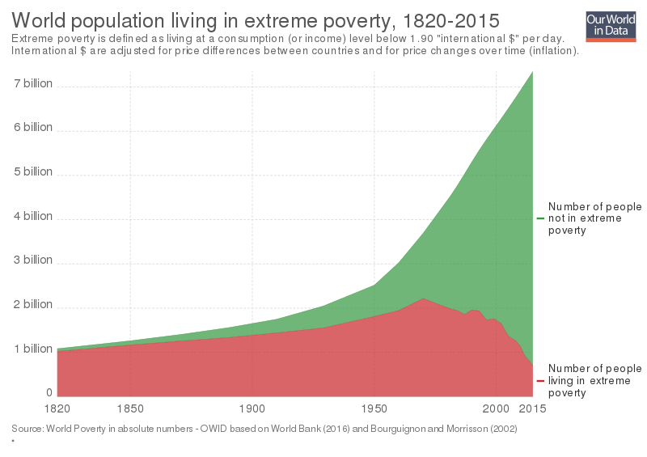
Notes:
Likewise, businesses can serve their communities by creating jobs, in addition to goods and services. In 1990, 1.8 billion people, 36% of the world’s population lived in extreme poverty. Today it is 0.6 billion, 8% of world population. Almost all of the reduction is due to businesses creating jobs. There is still a long way to go, and I regret that my country can’t seem to decide whether we are still committed to trade that benefits all economies.

Slide 27
Seek the welfare of the city where I have sent you.
(Jeremiah 29:7)
Busquen el bienestar de la ciudad adonde los he deportado
(Jeremías 29:7)
Notes:
Serving the communities where we live is an important, moral issue. God told his people “Seek the welfare of the city where I have sent you” (Jeremiah 29:7).
OK. I’ve given two reasons why work was created: To support yourself and your family; and to serve others. And I gave various ways you can do each of those in your work.

Slide 28
Why Work?
¿Por qué trabajar?
Work is good for you
  Desire to work
  Provide for family
Work serves others
  Products and services
  Co-workers
  Communities
Work forms character
El trabajo es bueno para ti
  Deseo de trabajar
  Proveer para la familia
El trabajo sirve a otros
  Productos y servicios
  Compañeros de trabajo
  Comunidades
El trabajo da forma al personaje
Notes:
I want to talk about one more reason to work: Work forms your character
The way you work forms the character of the person you are becoming. At work, you face decisions that can make you a better person, or a worse person. A stronger person, or a weaker person. Character is shaped by opposition. And if you work the right way, you are going to face opposition from people who want you to work the wrong way.

Slide 29

Notes:
Consider Dato George Ting. He is a business man, who owns Dominos, Pizza Hut, KFC and Shakey’s restaurants all over in Malaysia. His restaurants are constantly asked to pay bribes to local officials.
He says “The health department is an issue because you need licenses from them to operate a restaurant. We don’t indulge in giving them bribes. And actually over the years, if you establish a reputation for that, they respect it. The general rules I have for my people are that you comply with all the laws. Then they have no reason not to give you a license. They can only delay, but they cannot stop. In a small way or a big way, it doesn’t matter. You say no. But in the process of saying no, we have to pay the penalty—like paying a fine for speeding, but not bribing the officer.

Slide 30
We know that suffering produces perseverance; perseverance produces character; and character produces hope.
(Romans 5:3–4)
Sabemos que el sufrimiento produce perseverancia; la perseverancia produce entereza de carácter; la entereza de carácter produce esperanza.
(Romanos 5:3-4)
Notes:
I’m not trying to tell you what is the right thing to do in any situation you may face. I am saying that the decisions you make at work shape your character. The Bible puts it this way: “We know that suffering produces perseverance; perseverance produces character; and character produces hope” (Romans 5:3–4, NIV.) What kind of character do you hope to produce?

Slide 31
Notes:
The most difficult adversary we face at work is often ourselves. Our own prejudice, impatience, arrogance, lust for power—these things from inside can be a bigger barrier to our character than any demand from outside. Regrettably, I know this from sad experience, from a situation when my attitude was my biggest barrier to my character at work. It happened after I left McKinsey to help start a biomedical company. There were two of us running the company. Early on I said to my business partner, Hamilton, “I have to tell you that I am a Christian. That means I have a higher ethical standard. There are some things that are normal in business that I cannot do.” “OK,” he said, “anything you don’t think is ethical, we won’t do.”

Slide 32
Notes:
About a year later we were preparing a report for the board of directors. I wrote a page that said we had gained 5 new customers during the quarter. “What five customers?” Hamilton asked. I showed him the list. He said, “These last two aren’t customers. We haven’t received any orders from them yet.” I said, “Well, they both told me they’re going to place orders, so I think we can count them as customers.” Hamilton said, “If they haven’t bought anything from us, they’re not customers.” I realized, his ethical standards are higher than mine. And I was really embarrassed because I had been bragging about how being a Christian made me more ethical than him. Maybe exaggerating our customer list wasn’t the worst thing in the work, but what I’m ashamed of is thinking that I was better than him. True religion is not to judge other people, but to form our own character.

Slide 33
Notes:
But Hamilton forgave me—he didn’t hold my own words against me. And I asked God forgiveness too. God forgives mistakes, and we can learn from our mistakes. I’ve called this “character formation,’ but I could also call it “spiritual formation.” I’m talking about how the choices we make at work shape our inner selves, shape who we are. What could be more spiritual than that?

Slide 34
Why Work?
¿Por qué trabajar?
Work is good for you
  Desire to work
  Provide for family
Work serves others
  Products and services
  Co-workers
  Communities
Work forms character
El trabajo es bueno para ti
  Deseo de trabajar
  Proveer para la familia
El trabajo sirve a otros
  Productos y servicios
  Compañeros de trabajo
  Comunidades
El trabajo da forma al personaje
Notes:
There are more reasons God created work, but I think the three I’ve talked about are enough for tonight. 1) Work is good for you; 2) Work serves others; 3) Work forms character.

Slide 35


Notes:
I’ve been giving Bible verses as I make these points. I wonder whether you think the Bible has a lot to say about work, or whether I’ve been lucky even to find a few verses related to work. Then answer is that the Bible has a lot to say about work. I am the leader of an organization called the Theology of Work Project, Proyecto Teologia del Trabajo. A complicated name, but it just means the Bible applied to Work.

Slide 36
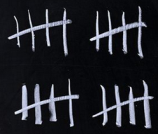


Notes:
We were created in 2007 to work through the entire Bible, passage by passage, to see what it says about work. By the time we finished 7 years later, we found 869 passages of the Bible that can guide people at work. In the Bible, God shows up where God’s people are, which is mostly at work. Very little of the Bible happens in temples, synagogues or churches. Most of the Bible happens in fields, pastures, workshops, government offices, military outposts, ships, roads, and homes. The places where people work.

Slide 37
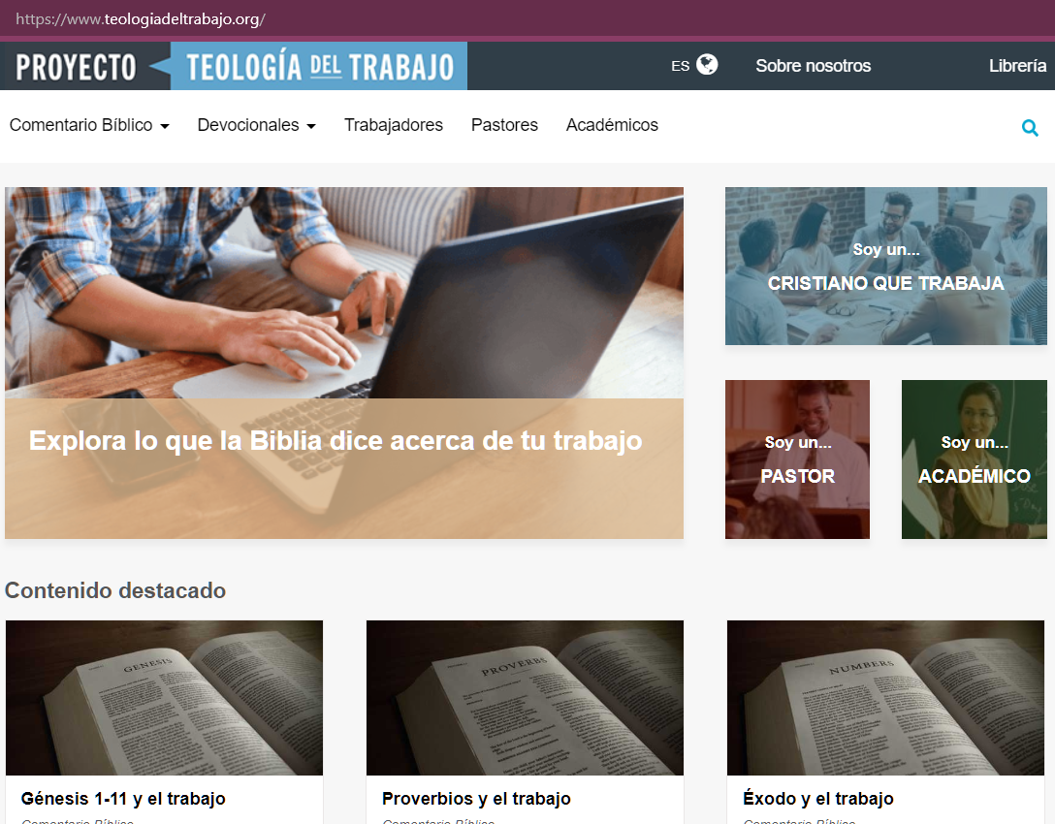
Notes:
Everything we do is free online. Go to our website teologiadeltrabajo.org, and see how the Bible can help you work better. We have a special section for Christians who Work, so you don’t have to be a Bible scholar or theologian. For example you’ll find pieces about ambition, leadership, handling failure, unemployment, making good decisions, challenges faced by working women, and lots of other practical topics.

Slide 38
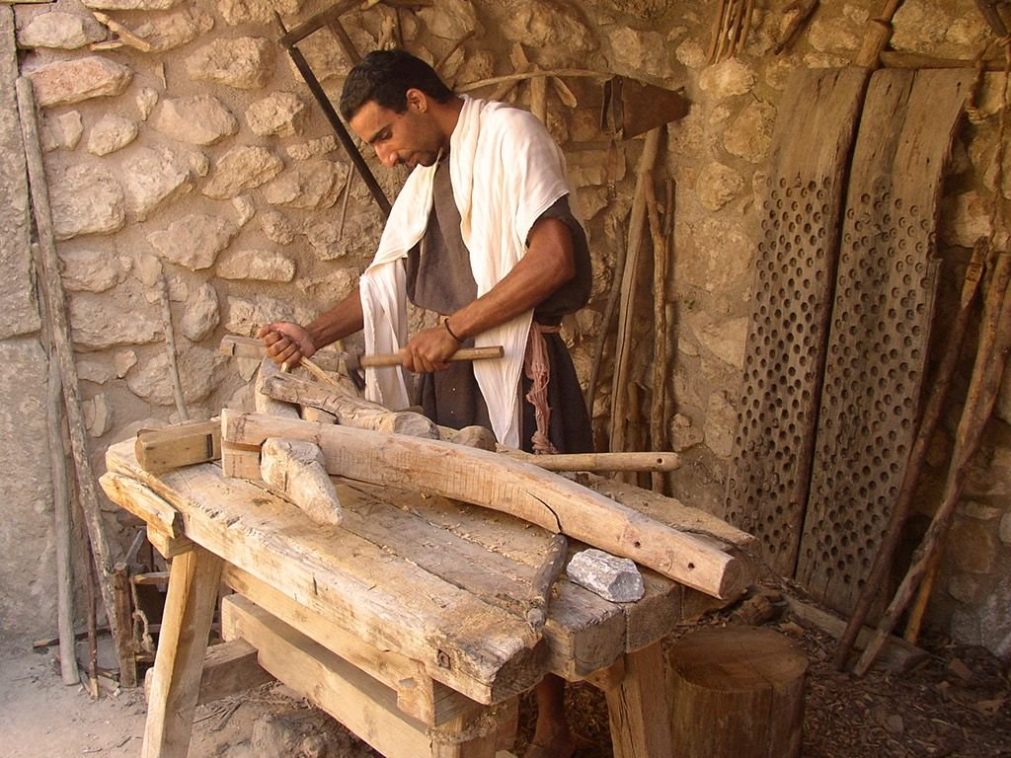
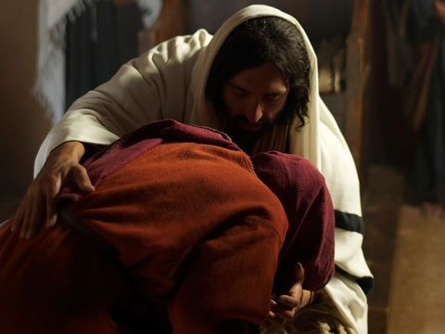
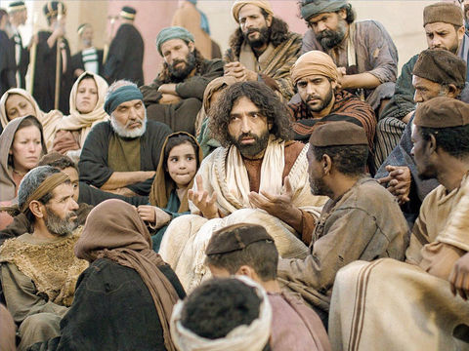
Notes:
So how do we work as we are created to work? By following the example of Jesus. In Jesus we find the highest expression of a worker. In his lifetime, Jesus had three main jobs. First, he was a carpentiero or constructador. He made a living with his hands. He supported his family. He made quality products. He handled customer complaints. He knew how to price a job to make a profit. Second, Jesus was a healer. People came to him sick, and he made them well. He is called El Gran Medico, no? Third, Jesus was a teacher. I mentioned before that some people work three jobs. I don’t know whether Jesus was poor, but he did have these three jobs. El constructador, el medico, el profesor. These are still among the most common occupations today: construction, health care, teaching. There must be many people in this room who are in one or more of these jobs, like Jesus.

Slide 39
“He has done everything well,” they said.
(Mark 7:37)
“Love each other,” Jesus said, “as I have loved you.”
(John 15:12)
La gente estaba sumamente asombrada, y decía: “Todo lo hace bien.”
(Marcos 7:37)
“Que se amen los unos a los otros, como yo los he amado”
(Juan 15:12)
Notes:
Jesus did all his jobs with excellence. When people saw his work, the Bible says, “They were overwhelmed with amazement. ‘He has done everything well,’ they said” (Mark 7:37). What made Jesus so good at his work? Love. Love. More than anyone else, Jesus loved people. “Love each other,” Jesus said, “as I have loved you” (John 15:12). The key to doing good work, work you can be proud of, work you can tell your mother about, is to love the people that your work affects: customers, suppliers, competitors, co-workers, bosses, subordinates, neighbors.

Slide 40
Notes:
The problem is, it’s hard to love people at work. It’s hard to see past me, to see the people around me. It’s hard to care about the person who will use my work, when I only care about the paycheck. It’s hard to do the right thing, instead of the easy thing. And the people we work with aren’t always lovable! It’s hard enough to love my family. How can I love my co-workers?

Slide 41
“Love the Lord your God with all your heart and with all your soul and with all your mind.” This is the first and greatest commandment. And the second is like it: “Love your neighbor as yourself.”
(Matthew 22:37–39)
“Ama al Señor tu Dios con todo tu corazón, con todo tu ser y con toda tu mente.” Este es el primero y el más importante de los mandamientos. El segundo se parece a este: “Ama a tu prójimo como a ti mismo.”
(Mateo 22:37-39)
Notes:
Jesus had an idea that can help. Someone asked him, what is the greatest commandment? What one thing can I do to work as God created me to work? Jesus answered: “‘Love the Lord your God with all your heart and with all your soul and with all your mind.’ This is the first and greatest commandment. And the second is like it: ‘Love your neighbor as yourself.’” (Matthew 22:37–39). When you work to love your neighbor as much as for yourself, then you are loving God. Did you hear what Jesus said, “the second is like the first”—loving your neighbor is like (like!) loving God. Isn’t this amazing! It is good to go to church. It is good to worship. It is good to pray. It is good to receive the Eucharist. And it is just as good to work to serve other people. This is why God created work. Because when we work, and our work serves other people, we love God.

Slide 42
Notes:
If we want to love others in our work, where can that love come from? From ourselves? Or from God? If you want God’s help in your work, all you have to do is ask. God will give us wisdom, skill, creativity, and excellence. And God will give us love if we ask. If we work with God’s love, then our work is not grim like death and taxes. Our work is great like the work of the greatest worker who ever lived, Jesus.

Slide 43
Notes:
Buenas noches mis amigos y que Dios los bendiga

